Slide 1
SHOPPING
WIZARD
Paris Arcos - Christian Herrero
Paúl Molano - Tam Tran - Pere Serra

Slide 2
CONTENTS
WHAT WE HAVE LEARNED
FOLLOWED STEPS
ISSUES DETECTED
DEMO

Slide 3





WHAT WE HAVE LEARNED
Lesson 1
Lesson 2
Lesson 3
Lesson 4
Lesson 5
We should choose some coding methodologies before start.
Validate forms using Javascript.
A Kanban is useful when the project start to grow.
We learned to code as a team with good communication, and support any fellow members who need extra support.
Cooperation and group problem solving to find new solutions. Members who have any issues can count on other members to solve it.

Slide 4
FOLLOWED STEPS
01
04
Analyze the project
Share the work
02
05
Create remote repository
Work together in the integration
03
06
Distribute the work
Fix bugs
We analyze together the requirements to plan the project
We shared all our files and plan how propose how to make the transition of each section
Create a repository in github to be able to synchronize the work
Cooperation and group problem solving to find new solutions
We assign a part of the project to each one and help each other if necessary
Use console.log as a tool to debug errors

Slide 5
FONT & COLORS
Roboto
(https://fonts.google.com/specimen/Roboto)
#808080
#fff
#000

Slide 6
ISSUES DETECTED
METHODOLOGY
DESIGN
SCALABILITY
We didn’t use any pattern to name the vars, classes, elements, etc.
We didn’t define a design template with elements, colors, etc.
The project is limited to the minimum required at the beginning. Would take time to increase the size of the shop.

Slide 7
ABOUT THE PROJECT
Link to website
Watch the video
Link to the repository

Slide 8
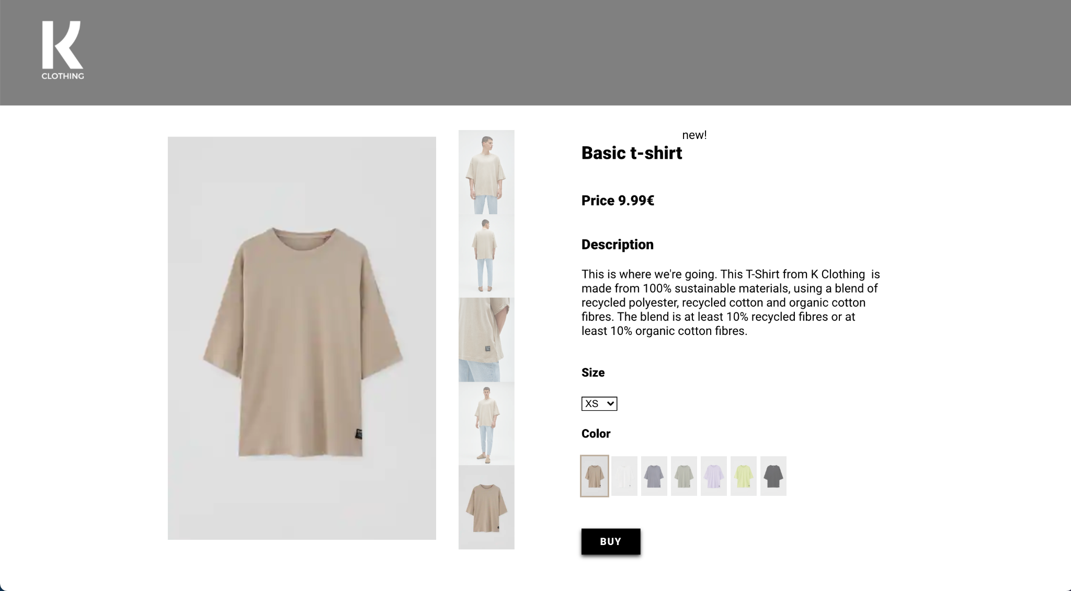

Slide 9
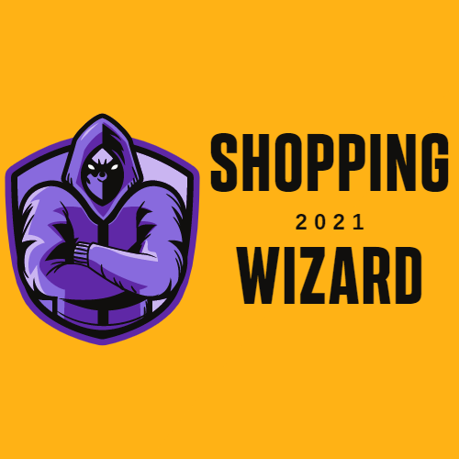
THANKS!
Does anyone have any question?
info@k-clothing.com
+91 620 421 838
k-clothing.com

